Slide 1


Neural-Enhanced Live Streaming : Improving Live Video Ingest via Online Learning
Jaehong Kim, Youngmok Jung, Hyunho Yeo, Juncheol Ye, Dongsu Han
SIGCOMM ‘20: Proceedings of the Annual conference of the ACM Speical Group on Data Communication on the applications, technologies, architectures, and protocol for computer communication
Dong Hyeon Lee
Chung-Ang University
enjoying1018@naver.com
August. 19th 2021

Slide 2
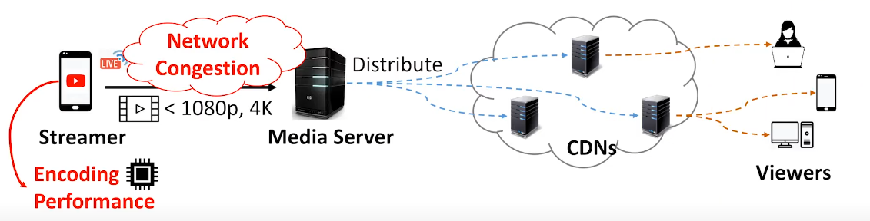
Streamer to Viewer
Ingest side

Slide 3
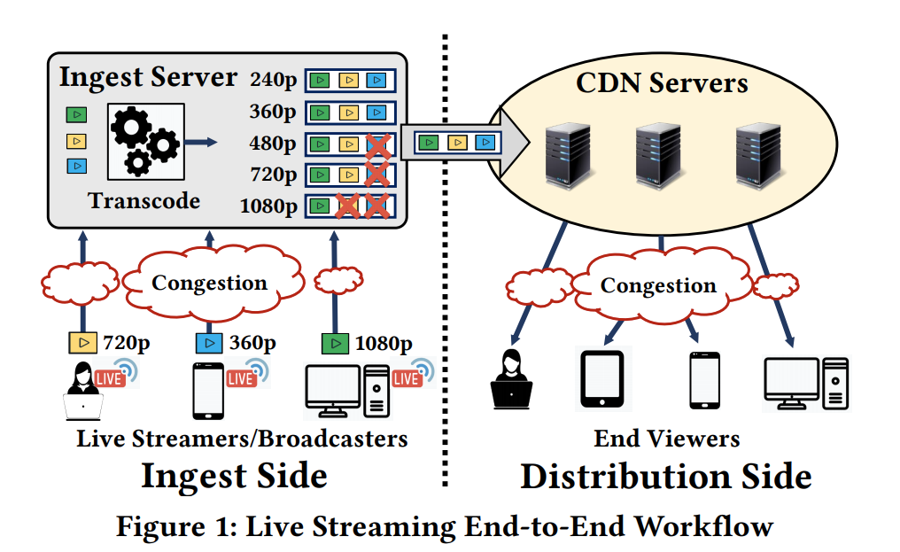
Streamer to Viewer

Slide 4
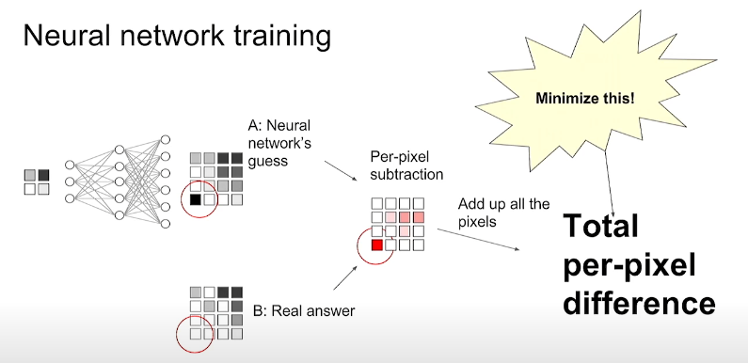
Super resolution(process of upscaling)

Slide 5
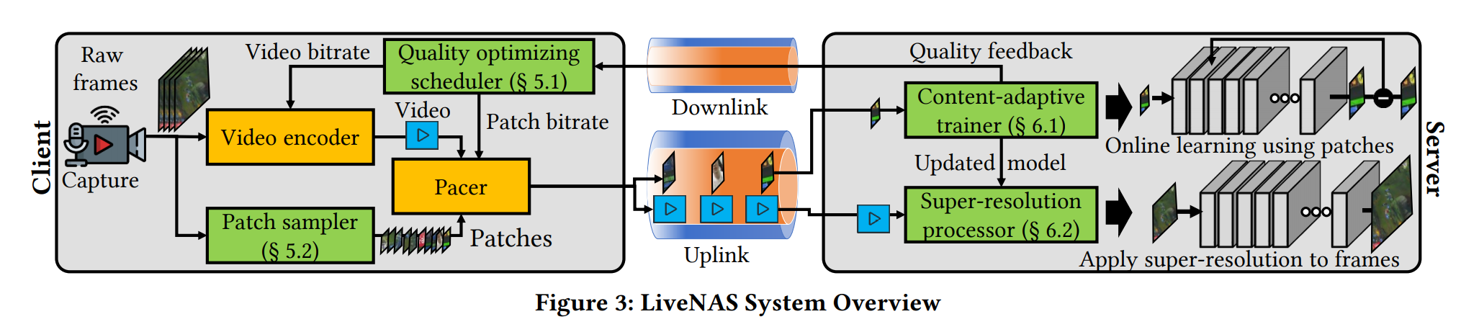
LiveNAS System

Slide 6
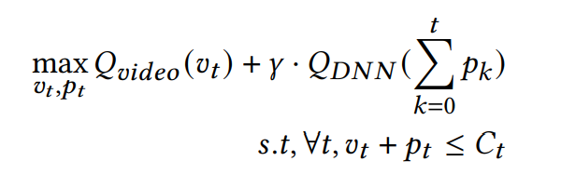
Quality optimizing scheduler(1)
Splits its use between the high-quality Labels(patch), and live video
Goal: maximize (quality of live video + future discounted expected quality gain due to online training)

Slide 7
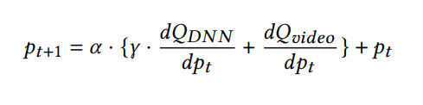

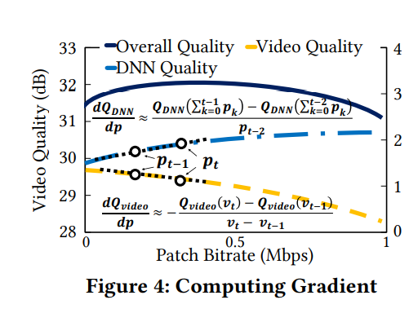
Quality optimizing scheduler(2)
Used gradient ascent to find the gradient ascent

Slide 8
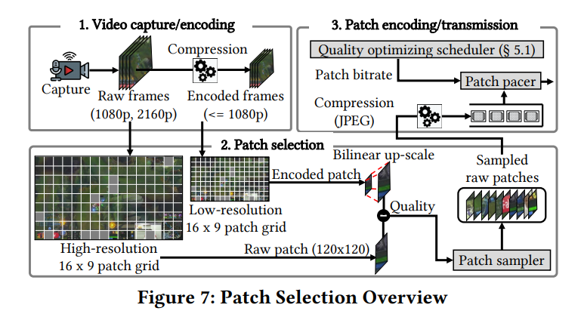
Patch sampler

Slide 9
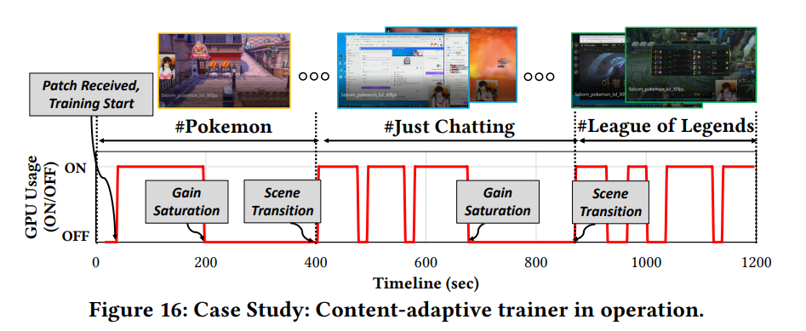
Content-adaptive trainer(1)
Trade-off between GPU training cost and video quality gain
➔ Scene change frequently = more GPU usage

Slide 10
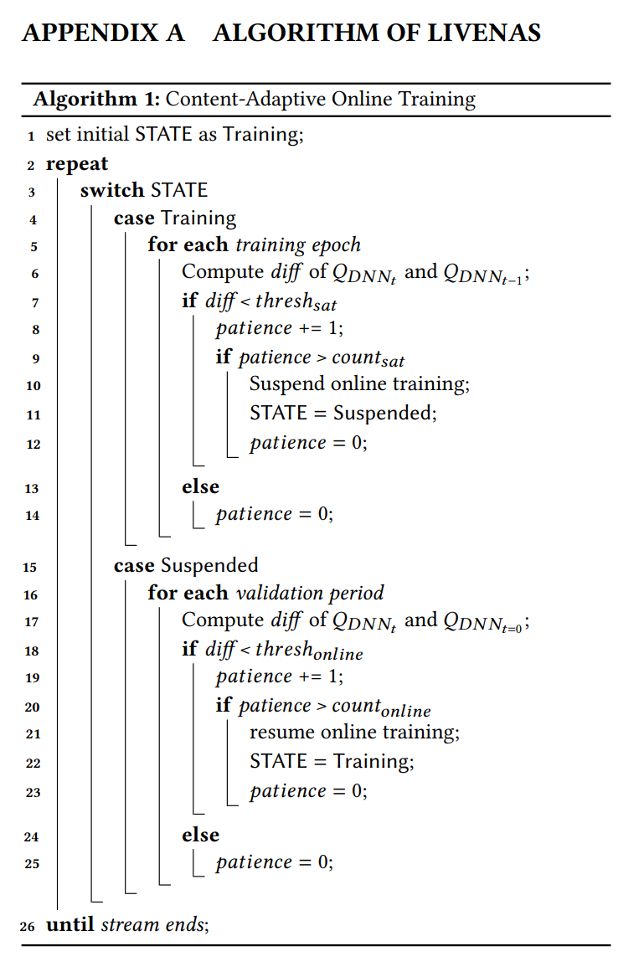
Content-adaptive trainer(2)

Slide 11
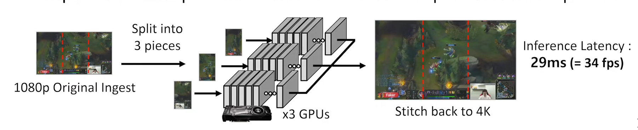
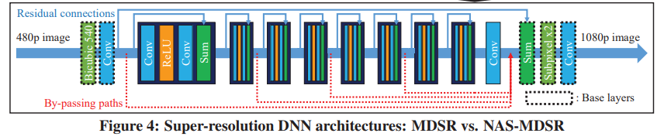
Super-resolution processor
Up to 1080p(1080p 의 영상까지만 더 개선시킬 수 있다)
With multiple GPU, Super-resolution processor can make 4K(분할처리)
Recent patch ->more weight (from trainer)

Slide 12
LiveNAS System- review
Input = 270p, 360p, 540p, 720p, 1080p
Output = 1080p or 4K

Slide 13
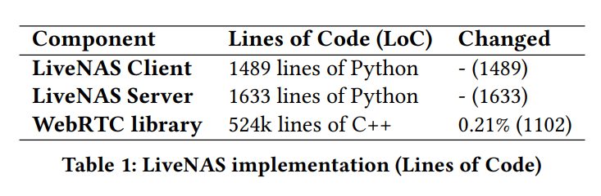
Implementation
Used webRTC Framework

Slide 14
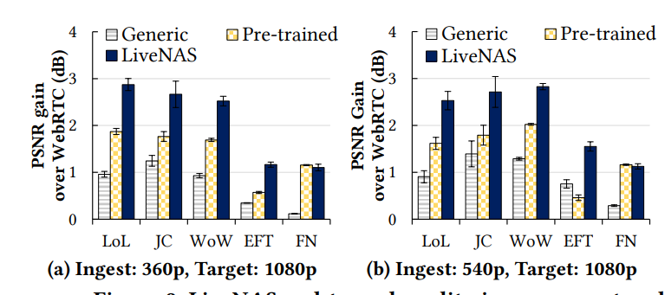
Evaluation(1) : used mahimahi emulator

Slide 15
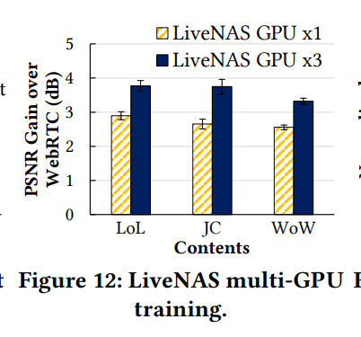
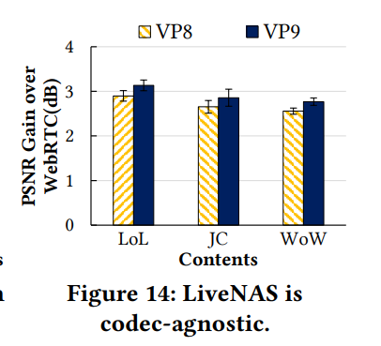
Evaluation(2) : used mahimahi emulator

Slide 16
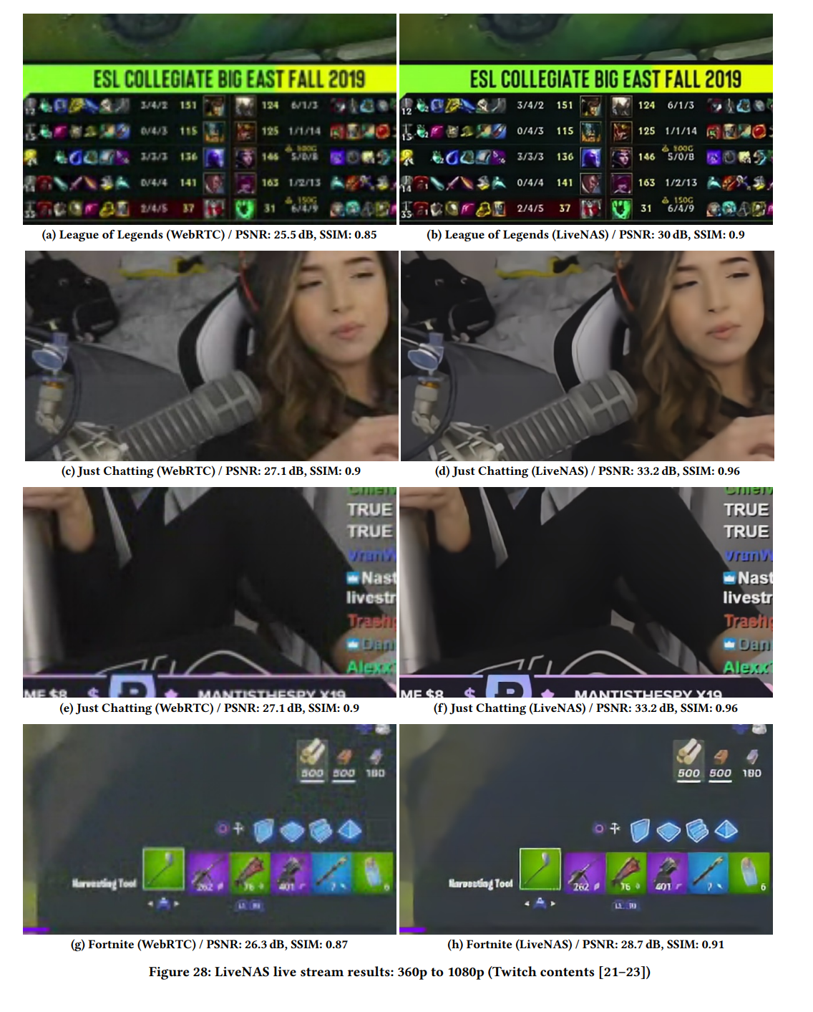
Real Example(1)

Slide 17
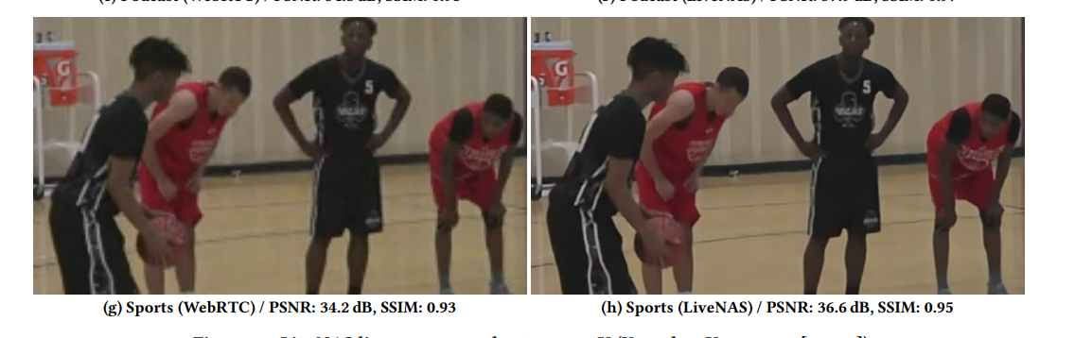
Real Example(2)

Slide 18



Thank you!

